Slide 1
MEMO Data Analysis
Sumaiya Islam Sharifa

Slide 2
During memo 2020-21
Pre-approved Casa Memo (Start date 23rd April 2020)
Employee Banking Memo (Start date 27th May 2020)
SBC Campaign Memo ( Start date 28th April 2021)

Slide 3
Total
6
42
317
253
6046

Slide 5
Total
70
14
219

Slide 7
Total
2
4
38

Slide 9
TOTAL
3
8
461
104
55

Slide 11
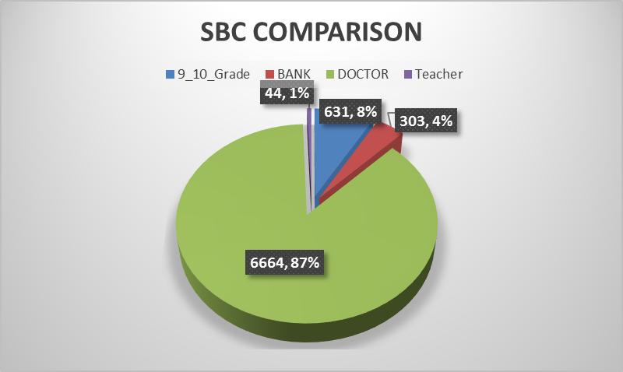
COMPARISON AMONG DOCTOR, BANKER, TEACHER, NON CADRE 9-10TH GRADE

Slide 13
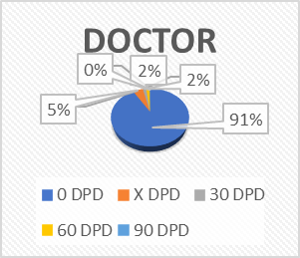
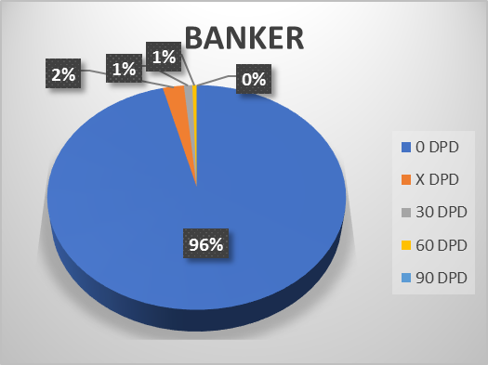
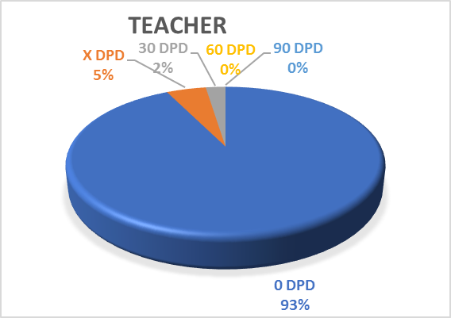
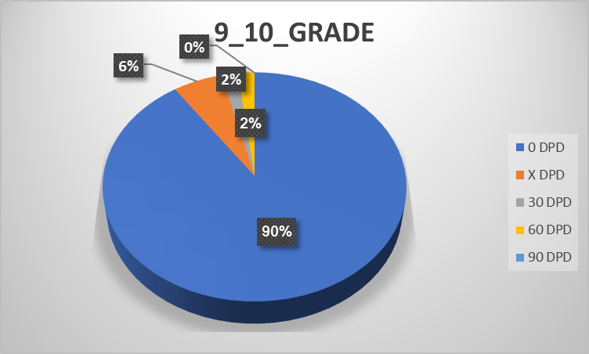
SBC: PORTFOLIO PERFORMANCE

Slide 14
Major Findings
File processing data are not organized according to Memo, difficult to find the exact data for certain memo. To find the data need to depend on the keyword which is not giving actual result all the time since different analyst write in different way. Hence accuracy of the report suffers.
For SBC MEMO, total 6391 files approved for 6045 customers.
346 file’s limit has been transferred to issue one card instead of 2 cards
Out of 6045 files it has been found that 773 cards multiple issued for same assessments.

Slide 15
Recommendation
For each campaign, fixed keyword must be used by all analysts while writing the comments. Campaign code field can also be used to assign the memo name to each file to ease the filtering of data based on memo.
Analyst may rotate under different supervisor periodically to transfer specific skills, knowledge, and competencies, leading to human capital accumulation.
After developing each memo, a short training needs to provide for business team on every memo to avoid collecting wrong file(s). It will save time for analyst as well as business team.

Slide 16
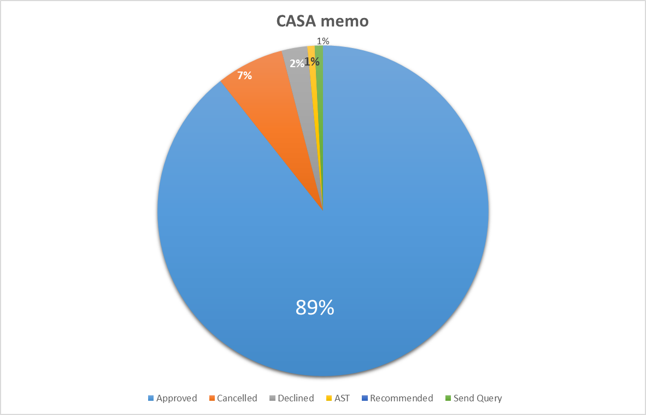
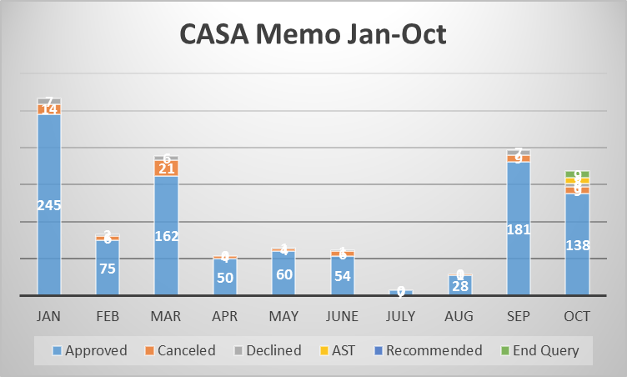
CASA Memo
Approved | 999
Cancelled | 74
Declined | 28
AST | 8
Recommended | 0
Send Query | 9
Total | 1,118
 | Approved | Canceled | Declined | AST | Recommended | Send Query
Jan | 245 | 14 | 7
Feb | 75 | 6 | 2
Mar | 162 | 21 | 6
Apr | 50 | 4 | 0
May | 60 | 4 | 1
June | 54 | 6 | 1
July | 7 | 0 | 0
Aug | 28 | 1 | 0
Sep | 181 | 9 | 7
Oct | 138 | 9 | 4 | 8 |  | 9

Slide 17
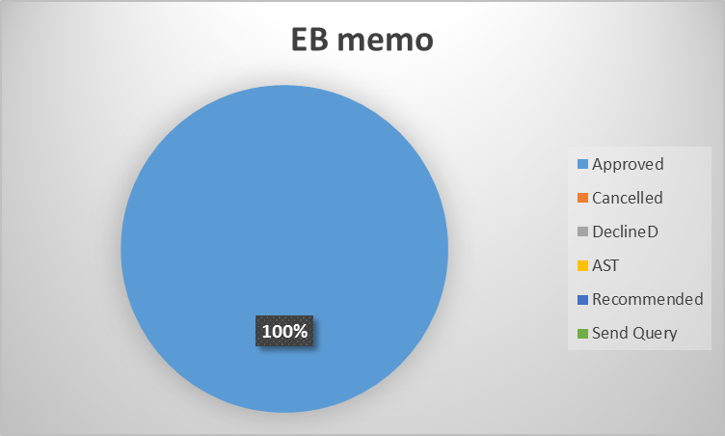
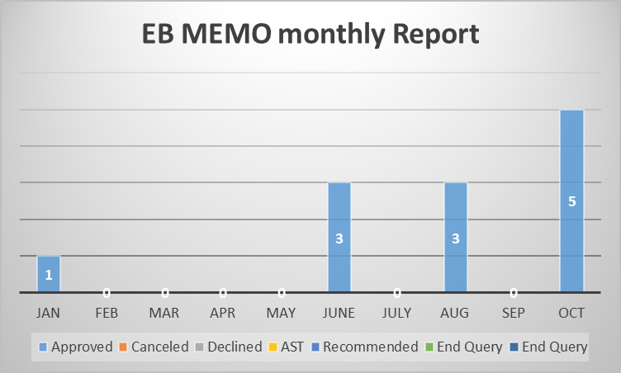
EB Memo |  | Total | 12
Approved | 12
Cancelled
Declined
AST
Recommended
Send Query
 | Approved | Canceled | Declined | AST | Recommended | End Query | End Query
Jan | 1
Feb | 0
Mar | 0
Apr | 0
May | 0
June | 3
July | 0
Aug | 3
Sep | 0
Oct | 5
Total | 12

Slide 18
THANK you
ANY QUESTION ?

